Slide 1
Solar Energy
Created with AI Presentation Generator

Slide 2
Introduction
The future of renewable energy holds immense promise, with innovations in technology and infrastructure poised to transform the way we generate and consume power. As the world transitions away from fossil fuels, renewable energy sources are becoming increasingly important. This presentation will explore the current state and future prospects of solar, wind, and hydropower, highlighting their benefits, challenges, and trends.

Slide 3
Solar Energy
Solar energy is becoming increasingly cost-competitive with fossil fuels, making it a viable option for electricity generation worldwide.
Advancements in solar panel technology have improved efficiency, allowing for more power to be generated from smaller installations.
The global solar market is expected to continue growing, with emerging economies driving demand.

Slide 4

Wind Energy
Wind energy has become a major player in the renewable energy market, with large wind farms generating significant amounts of electricity.
Advances in turbine design and materials have increased efficiency and reduced costs, making wind energy more competitive.
Offshore wind farms are becoming increasingly popular, offering greater energy potential and reduced visual impact.

Slide 5

Hydropower
Hydropower remains one of the oldest and most reliable forms of renewable energy, providing a stable source of electricity.
Large-scale hydropower projects can have significant benefits, including flood control and irrigation.
Run-of-river hydropower plants are becoming more popular, offering a more sustainable and environmentally friendly option.

Slide 6

Benefits of Renewable Energy
Renewable energy sources reduce greenhouse gas emissions, helping to mitigate climate change.
Renewable energy can create jobs and stimulate local economies, particularly in rural areas.
Renewable energy can improve energy security by reducing dependence on imported fuels.

Slide 7
Challenges Facing Renewable Energy
Intermittency and variability can make it difficult to integrate renewable energy into the grid.
High upfront costs can be a barrier to adoption, particularly for small-scale installations.
Policy and regulatory frameworks can create uncertainty and hinder the growth of renewable energy.

Slide 8
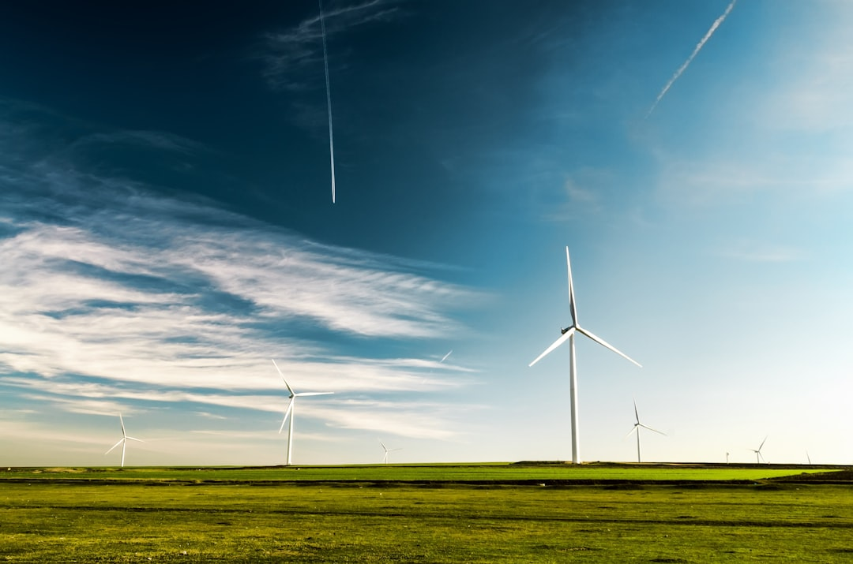
Future Trends in Renewable Energy
Energy storage technologies, such as batteries, are becoming increasingly important for addressing intermittency issues.
Smart grids and advanced weather forecasting can improve the integration of renewable energy into the grid.
New technologies, such as floating wind turbines and advanced solar panels, are being developed to increase energy production.

Slide 9
Conclusion
The future of renewable energy is bright, with solar, wind, and hydropower playing increasingly important roles in the global energy mix. While challenges remain, the benefits of renewable energy make it an essential part of a sustainable energy future. As technology continues to evolve and costs decrease, renewable energy will become an even more viable option for electricity generation worldwide.

Slide 10
Thank You!
Questions & Discussion

